Slide 1

Credit Records
By Jodee Harris

Slide 2


Agenda
Purpose
Data Design
Results
Sources

Slide 3


Purpose
Is having less or more assets going to affect the eligibility of credit card approvals regardless of credit scores? The purpose of this is for consumer education on how other necessity bills may affect your eligibility for credit or your scheduling of payments.

Slide 4



DATA design

Slide 5



Programs
MongoDB
Tableau
Jupyter & python
Used to store the data and aggregate the two CSV files together.
Used to form visual graphs for the presentation and present how the personal information interacted with status.
Used to clean the data and formulate the algorithms using sklearn library metrics for the trained models to predict the safe to unsafe credit scores.

Slide 6
Explaining the Data
Credit_record.CSV
Application_record.csv
One ID number had multiple accounts.
MONTHS_BALANCE is recording the month of the extracted data’s starting point, going backwards from 0. Example, -1 is the previous month, and so on.
STATUS was ranging from 0-5 equaling variating dates of delinquency from 1 to 150 days or more marking delinquencies, C meant paid off that month, X meant no loan for the month.
ID, Gender, FLAG_OWN_CAR, FLAG_OWN_REALTY, CNT_CHILDREN, AMT_INCOME_TOTAL, NAME_INCOME_TYPE, NAME_EDUCATION_TYPE, NAME_FAMILY_STATUS, NAME_HOUSING_TYPE, DAYS_BIRTH, DAYS_EMPLOYED, DAYS_EMPLOYED, FLAG_WORK_PHONE, FLAG_PHONE, FLAG_EMAIL, OCCUPATION_TYPE, CNT_FAM_MEMBERS.

Slide 7
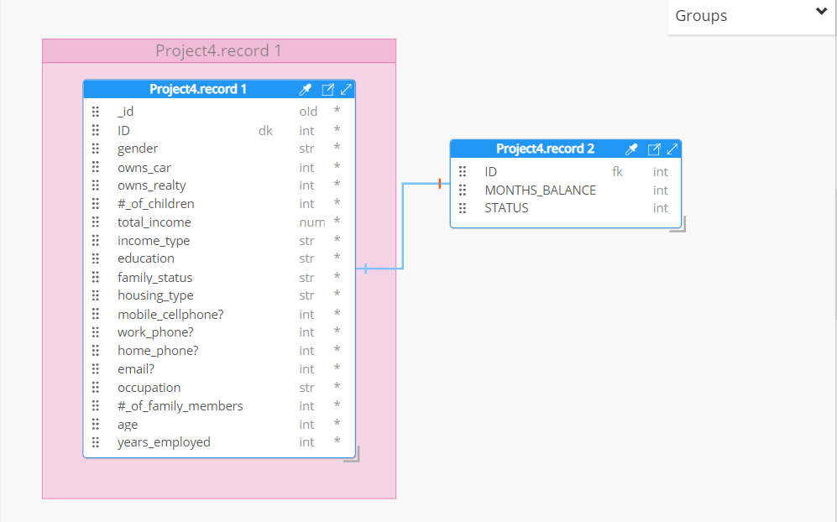
Schema via hackolade

Slide 8
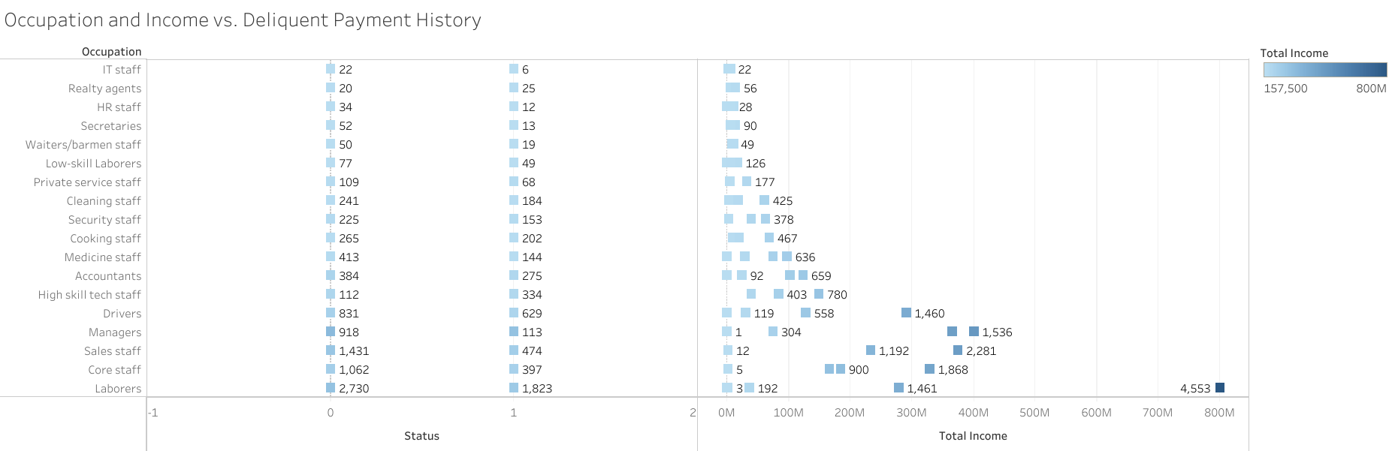
Table
 | Category 1 | Category 2 | Category 3 | Category 4
Item 1 | 4.5 | 2.3 | 1.7 | 5
Item 2 | 3.2 | 5.1 | 4.4 | 3
Item 3 | 2.1 | 1.7 | 2.5 | 2.8
Item 4 | 4.5 | 2.2 | 1.7 | 7

Slide 9
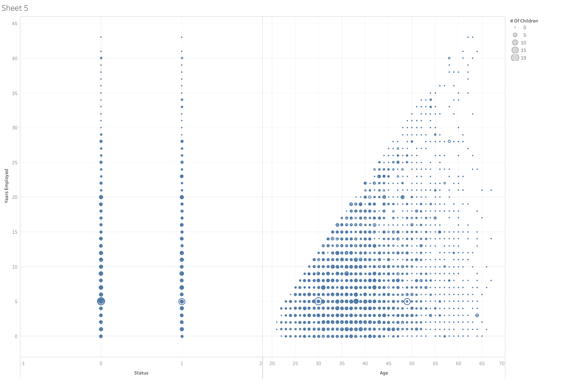
Age to Children to Status

Slide 10
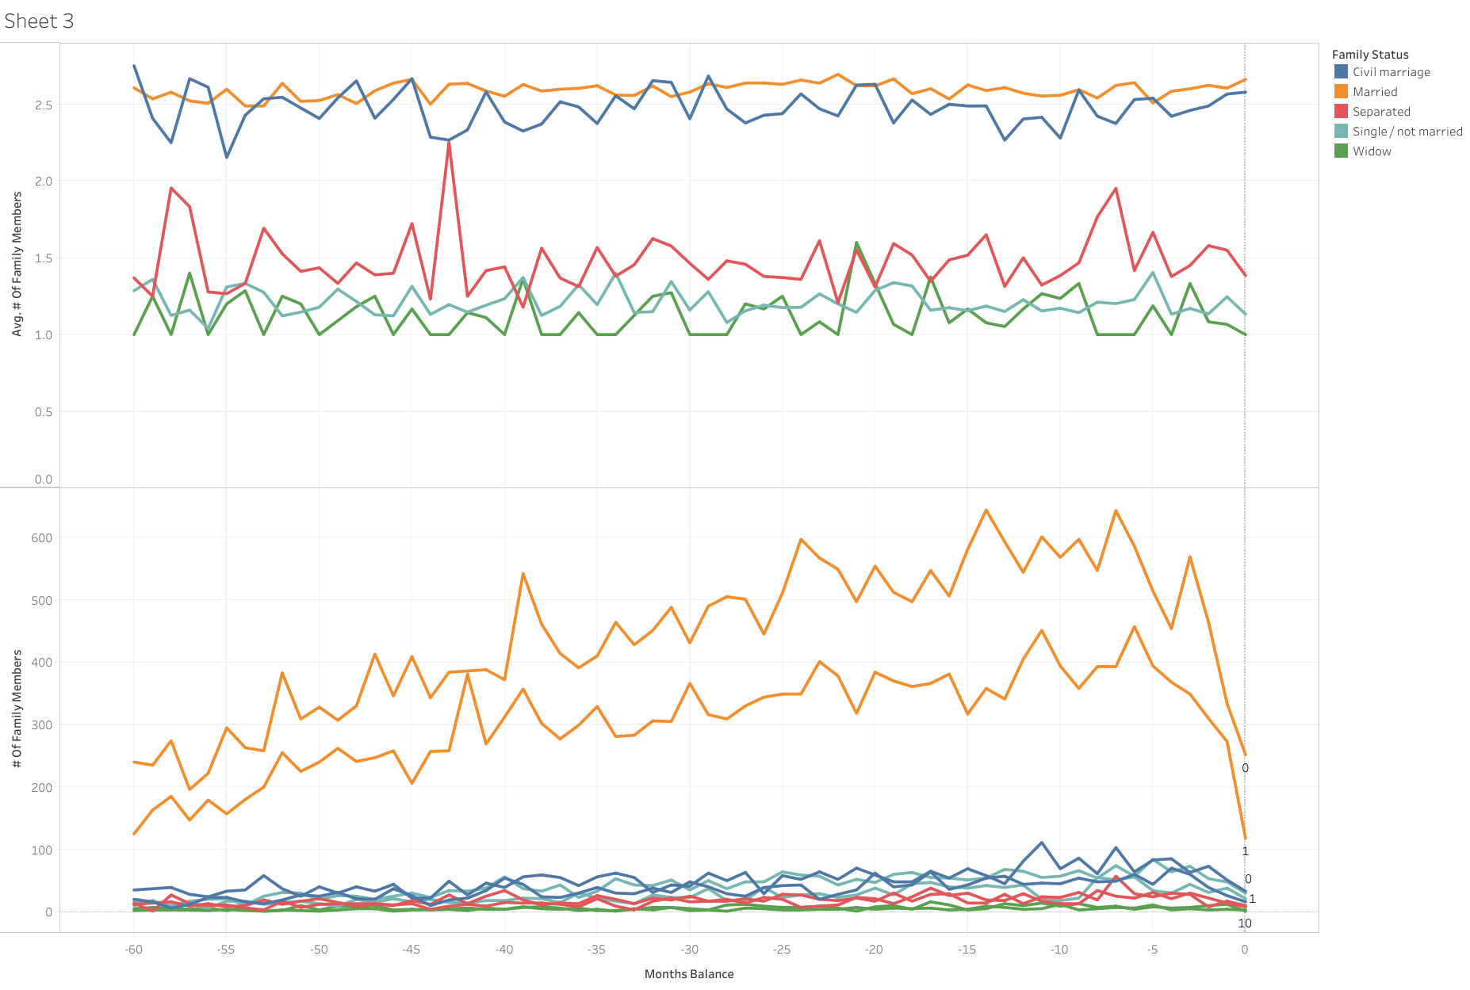
Status, # of Family vs. Months

Slide 11
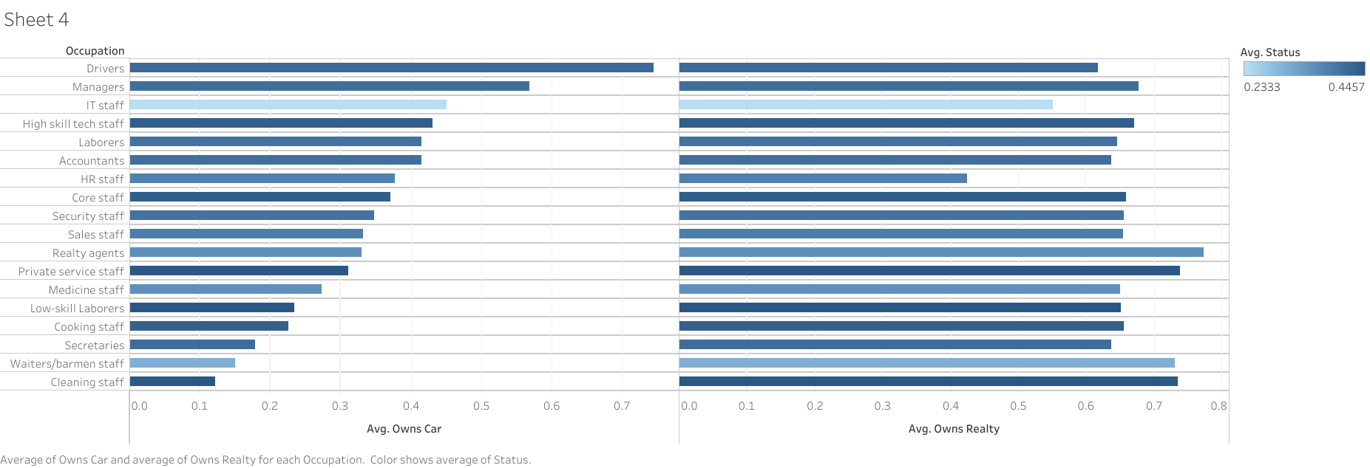
Occupation Versus Avg. Status

Slide 12

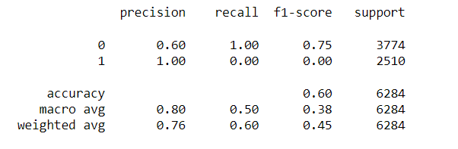
The prediction of the logistic regression model has no rate of success in Precision identifying the '0’ (delinquent credit reports) and high rate for '1’ (good or paid off credit reports). in recall ‘0’ there is a 100% of STATUS, while ‘1’ has a 0% recall of dues paid . The F1-score of 75% reflects the measure of precision to recall of this class. In summary, this is a skewed logistic regression model that has a higher result relevancy, with low to none truly relevant results returned for status Credit Reports.
BALANCED ACCURACY %

Slide 13




Results
Due to the data results being skewed in the predication models, this would not be a reliable source to determine good credit reports. Based on the information learned though the visuals of data, children and other necessities did not affect the status of peoples delayed payments. Occupation seemed to affect how long payments proceeded, or how the status of good or bad credit reports swayed.

Slide 14

Sources
https://www.kaggle.com/datasets/rikdifos/credit-card-approval-prediction?select=credit_record.csv
https://scikit-learn.org/stable/auto_examples/model_selection/plot_precision_recall.html
https://www.geeksforgeeks.org/
https://stackoverflow.com/
https://towardsdatascience.com/change-column-data-type-in-pandas-954d7acdef1d

